Slide 2
1000ms 1,5,10,20,30cycle

Slide 3
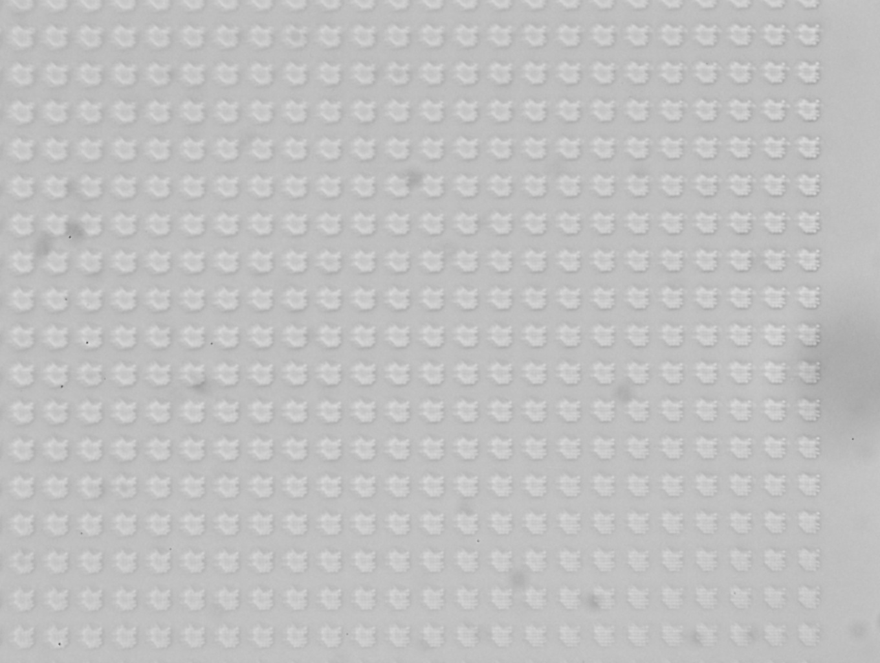
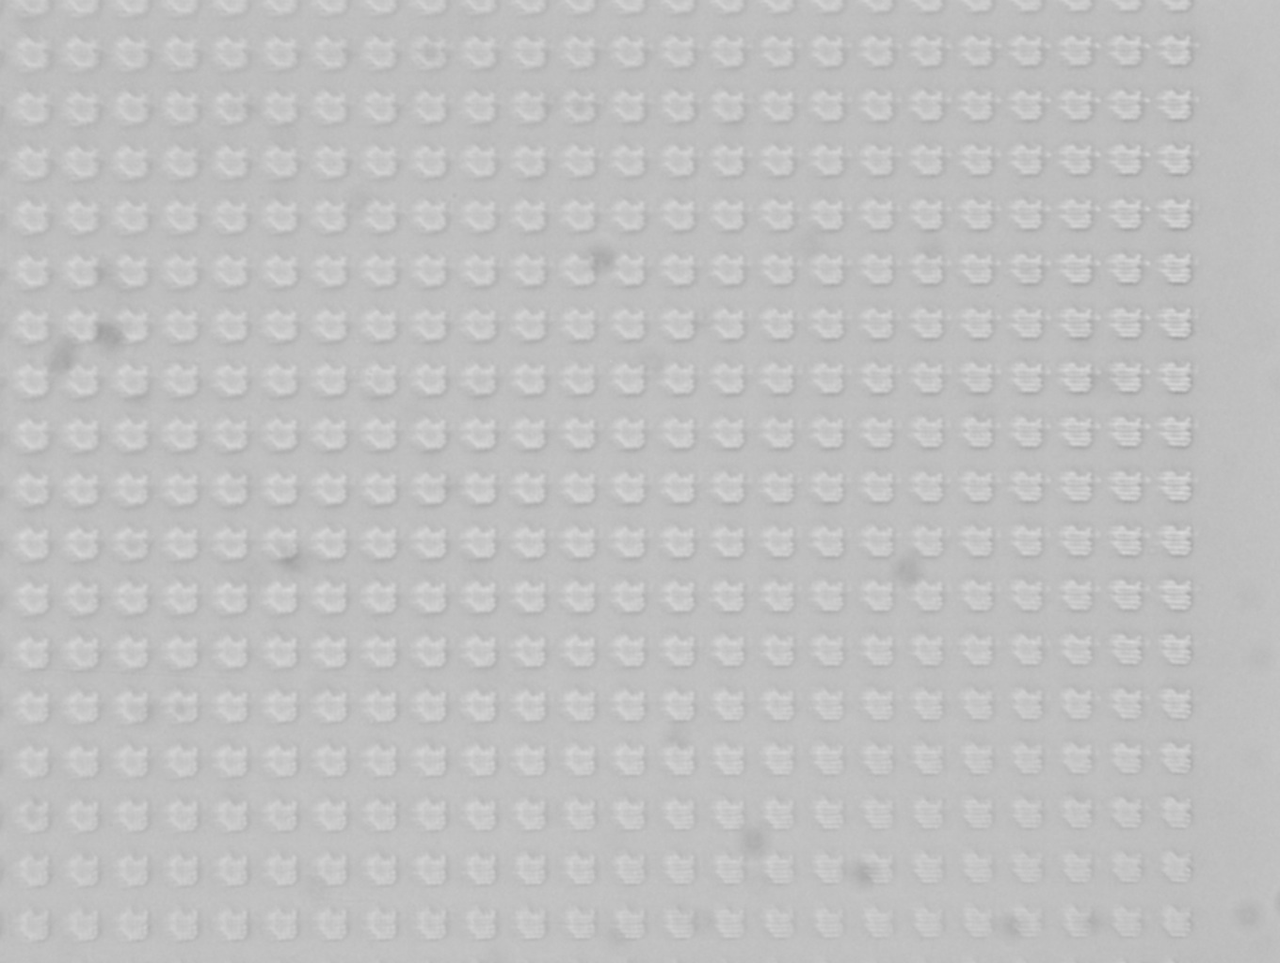
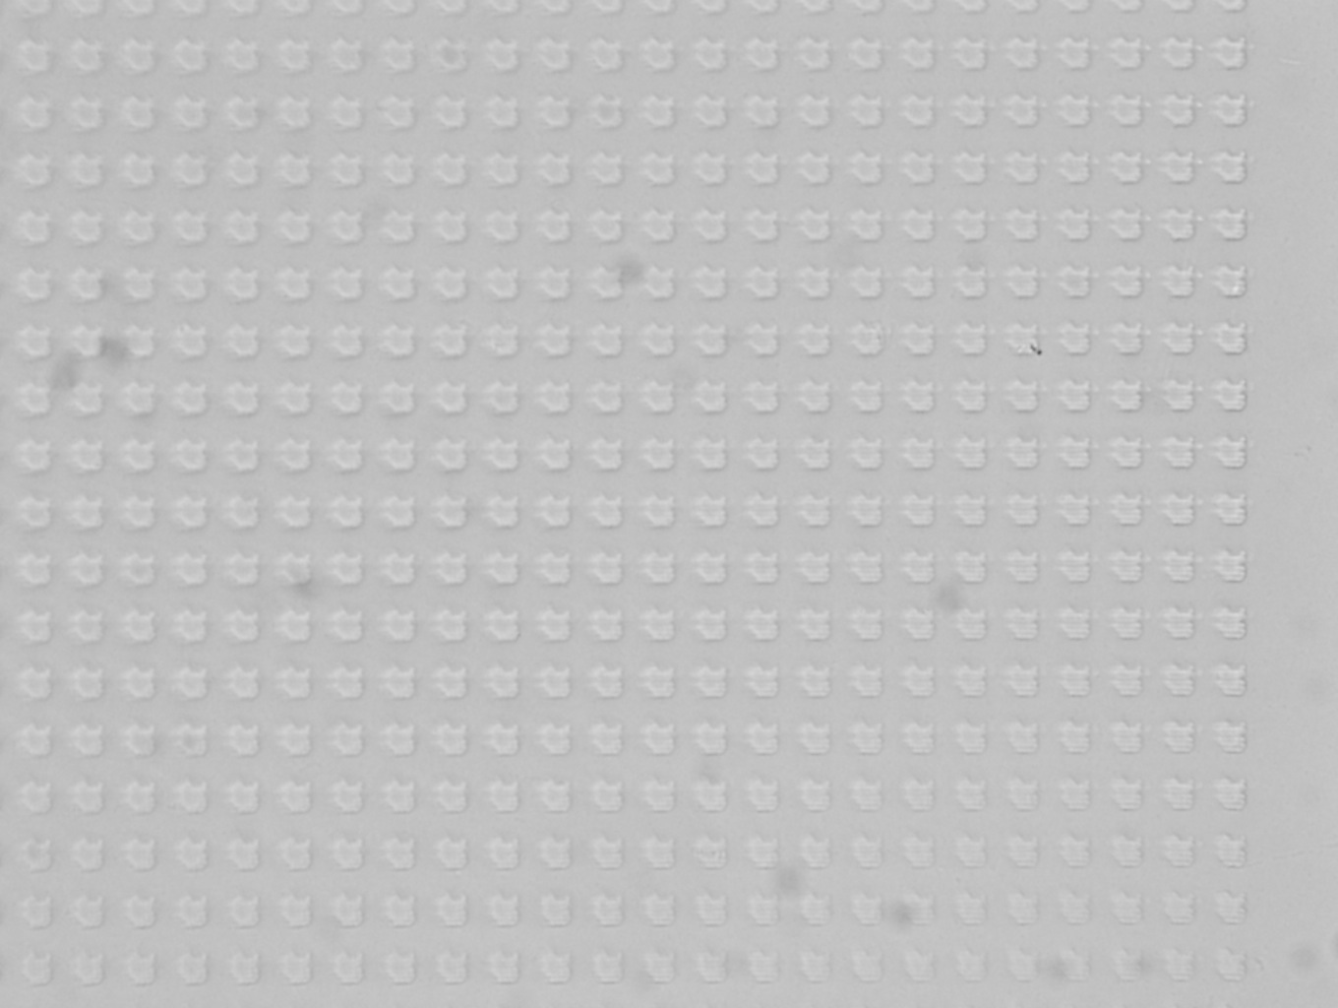
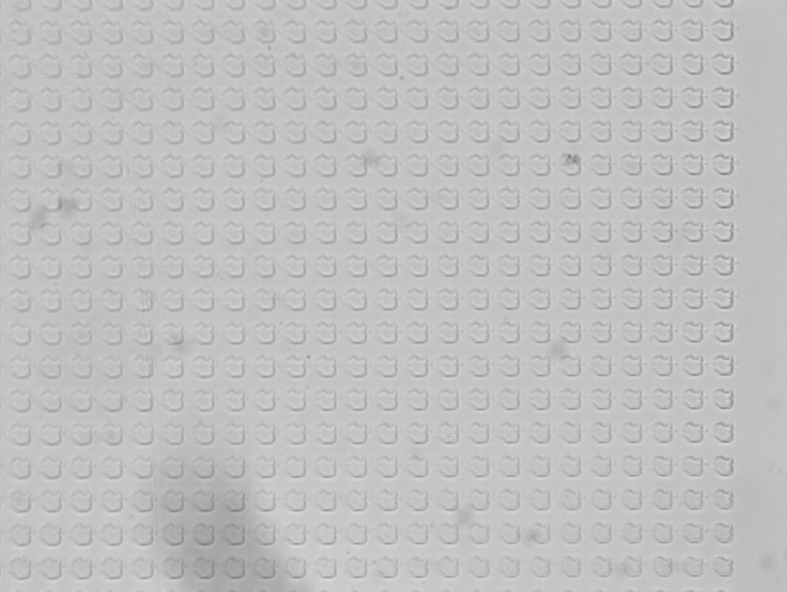
(a)
(b)
(c)
(d)

Slide 4
2 step
Fast shifting(60 step/second)

Slide 5




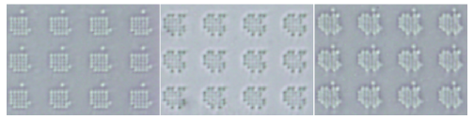
High resolution mask
(16 x 16)
Low resolution mask
(8 x 8)
16 x 16
Reconstructed mask
(8x8 wobulation)
Wobulation mask lithography
Ideal mask
Mask1 Mask2 Reconstructed pattern

Slide 6
(b)
Mask1 Mask2 Reconstructed pattern

Slide 7
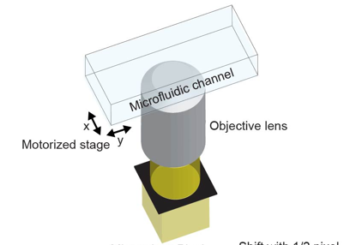

Slide 8
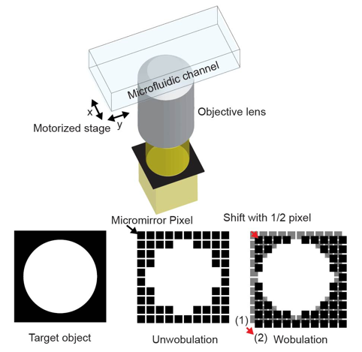
Target Object
Single Mask
Shifted Mask

Slide 9
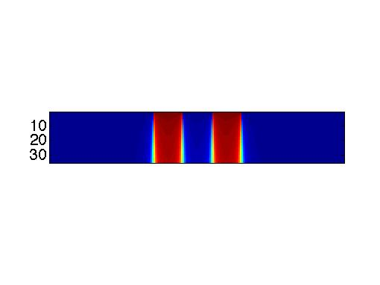

Slide 10
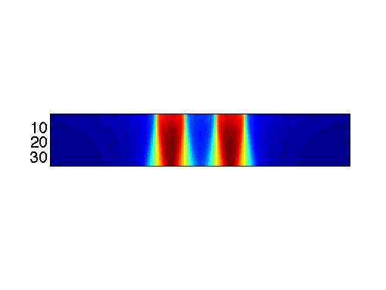

Slide 11
